Slide 1
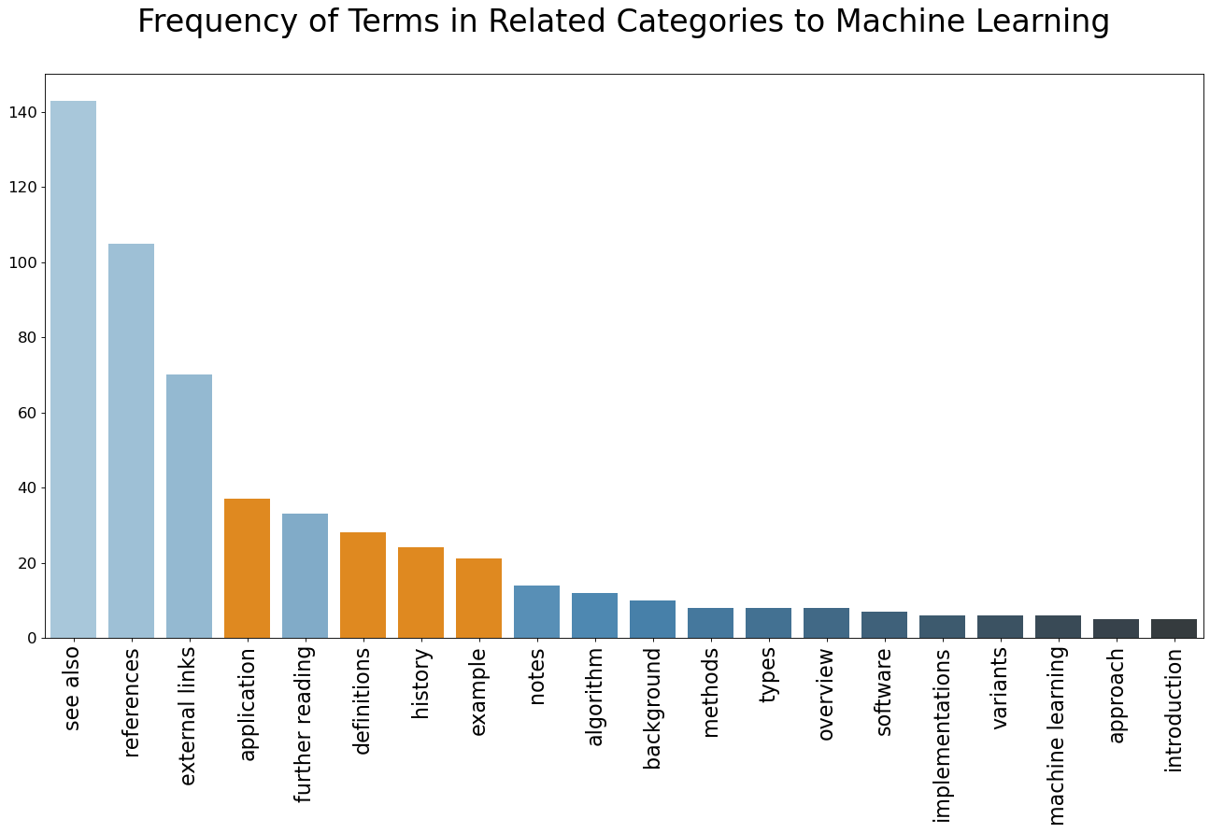
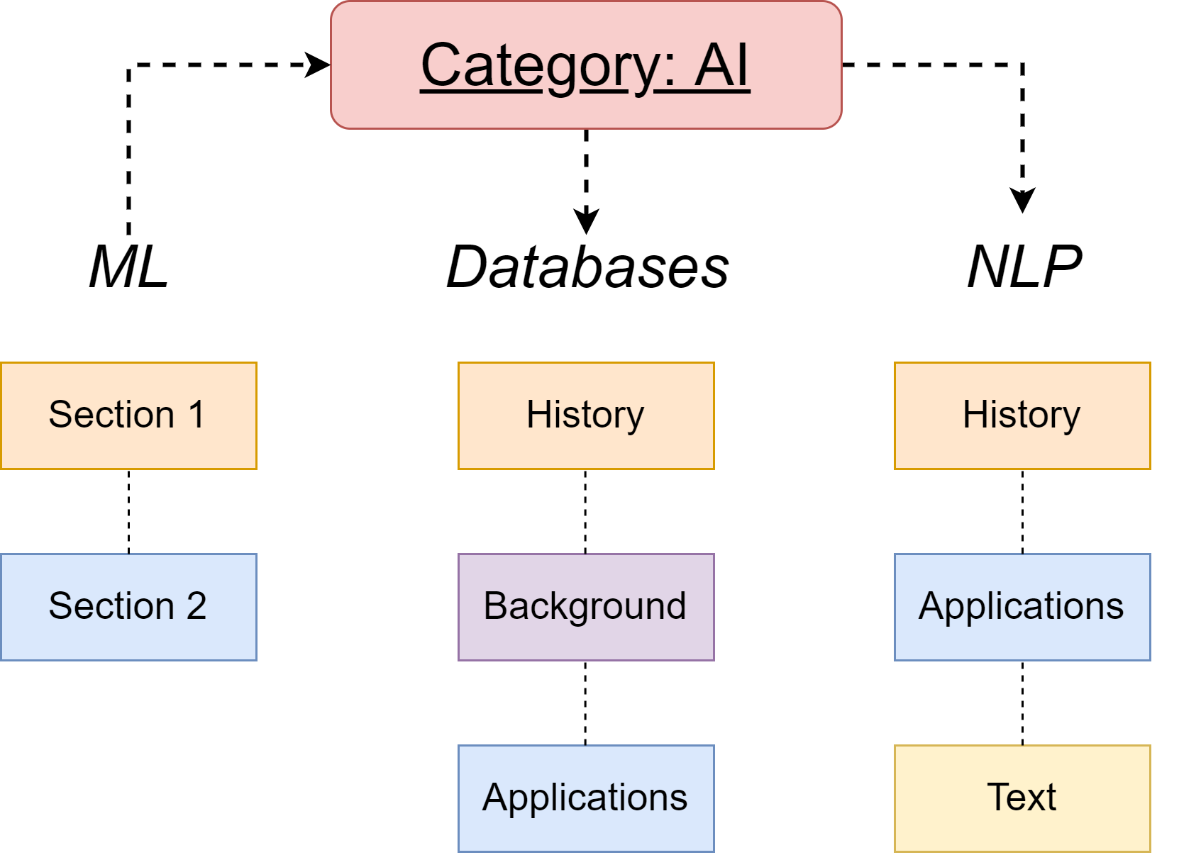
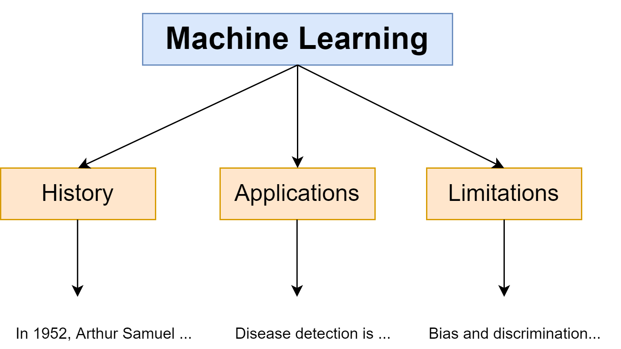
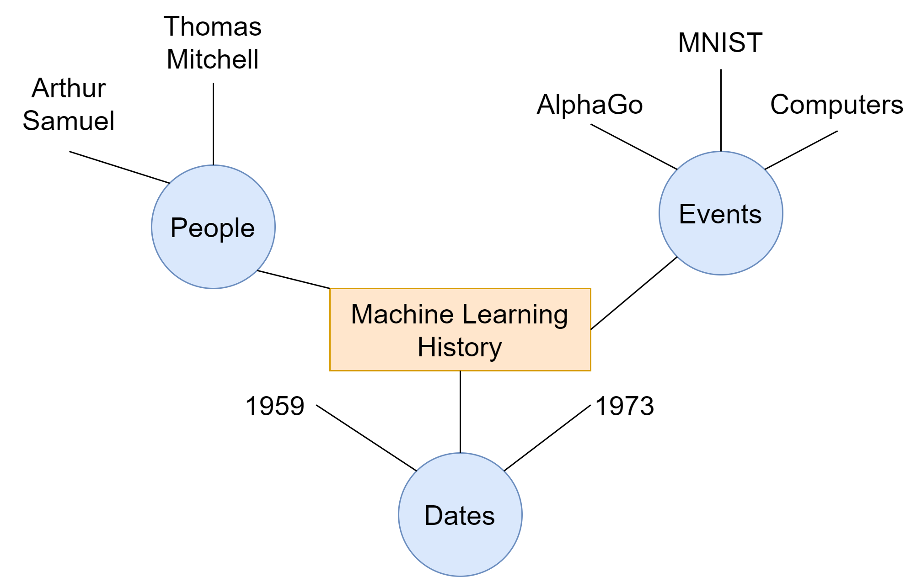

Living Dictionary: Automatically Generating Wikipedia-like Content
Nishant Balepur, Professor Kevin Chen-Chuan Chang
Siebel Center for Computer Science, Grainger College of Engineering, University of Illinois at Urbana-Champaign
INTRODUCTION
Problems with Current Wikipedia
Computer science is growing exponentially, so it becomes more challenging to keep track of the field
Without up-to-date information, entering computer science becomes more difficult
Our Approach
Recent advancements in text generation employ structured outlines for a more informative output
We adopt a similar approach with LivDic by creating a content tree rooted in the specific keyword
METHOD
Our LivDic framework has two subproblems:
Identifying sections for our content tree
Generating text under each section
Section Identification
Related fields to machine learning, like databases and NLP, should have similar section titles
We can select the top 5 most frequent sections under the keyword’s category to structure our content tree
Instance Classifier
Hypothesis: Wikipedia sections can be split into a list of “instances”
An instance can broadly be defined as a topic or idea within a certain section (dates, people, etc.)
If we teach LivDic what instances of a section should look like, we can use it to identify instances on websites and use that as our content
RESULTS
Section Identification
Framework is simple but effective: finds highly plausible candidates
Instance Classifier
LivDic is evaluated using recall, the ability to identify true positives
Training, validation, and testing sets boast impressive recall values of 1.0, 0.8047, and 1.0, respectively
Sample Article Generation
LivDic’s summaries contain more in-depth information than current techniques [3]
Our content is thorough, but not too long, preserving around 40% of the original article
CONCLUSIONS
Contributions
LivDic is highly proficient at completing its two subproblems
It can identify probable sections for our content tree and can extract summaries for these sections
Future Work
Fixing current issues: source article selection and eliminating extraneous web scraped text
Generating a large dataset for computer science keywords
Evaluating on traditional ROUGE metrics for more empirical results
Using insights from human perspectives on readability, relevancy and redundancy
Figure 4: Mined sections for machine learning
REFERENCES
[1] Liu, Peter J., et al. “Generating Wikipedia by Summarizing Long Sequences.” ArXiv:1801.10198 [Cs], Jan. 2018. arXiv.org, http://arxiv.org/abs/1801.10198.
[2] Zhu, Fangwei, et al. “TWAG: A Topic-Guided Wikipedia Abstract Generator.” ArXiv:2106.15135 [Cs], June 2021. arXiv.org, http://arxiv.org/abs/2106.15135.
[3] Gambhir, Mahak, and Vishal Gupta. “Recent Automatic Text Summarization Techniques: A Survey.” Artificial Intelligence Review, vol. 47, no. 1, Jan. 2017, pp. 1–66. Springer Link, https://doi.org/10.1007/s10462-016-9475-9.
Figure 1: An example content tree for machine learning
Figure 2: Mining visualization for machine learning
PURPOSE
What Previous Work Exists?
Past work focuses on generating the Wikipedia abstract [1] or needs references as input [2]
With LivDic, we solve these issues with a novel approach to text summarization
Why does LivDic Matter?
We enable information in computer science to become more accessible to beginners
Improving upon information retrieval supports the idea of knowledge freedom as opposed to commoditization
We can avoid historical problems of outdated or biased information from a single source
History of Machine Learning
Businesses increasingly rely on tools that use ML
algorithms to provide them with accurate data for
improving and growing their organization.
While machine learning may seem like a very recent
concept, you may be surprised to know that the history of
machine learning dates back to the 1940s. However, it
wasn’t until the 1950s that we saw how ML works for the
first time.
…
ACKNOWLEDGEMENTS
I would like to thank Professor Kevin Chen-Chuan Chang for his continued support throughout this project. Also, a special thanks to Dr. Natasha Mamaril and the ISUR/C3SR teams for making this experience possible and opening my eyes up to the world of research.
Figure 2: Instance knowledge graph for machine learning history
Figure 5: Generated section for ‘history of machine learning’

